Slide 1
Litoria Frog Data

Slide 2
Litoria Fallax
System: Terrestrial, Freshwater (=Inland waters)
Habitat: Wetlands (inland), Artificial/Aquatic & Marine
Breeding: Water body areas with vegetation
known in Australia for becoming lost frogs by turning up in fruit shops outside of their normal range

Slide 3
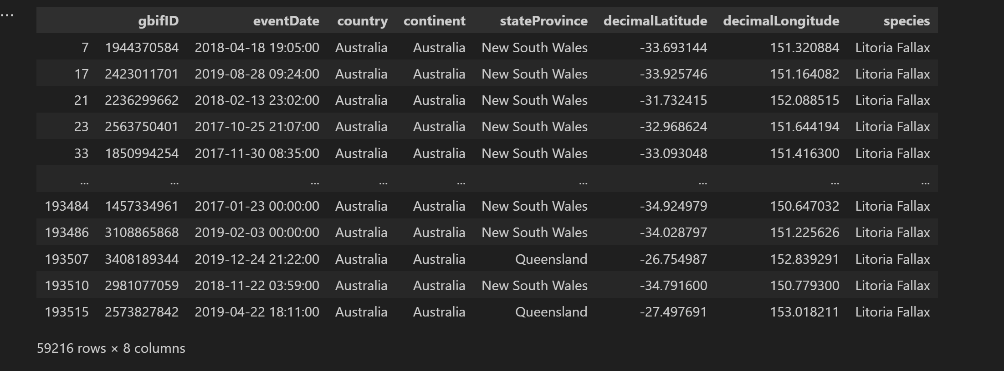
Occurrence Data
Contains when, where and what species of frog spotted
Relevant information such as
Species
Coordinates
Event time

Slide 4

Weather Data
x – Longitude
y – Latitude
Band – contains an average of all weather information

Slide 5
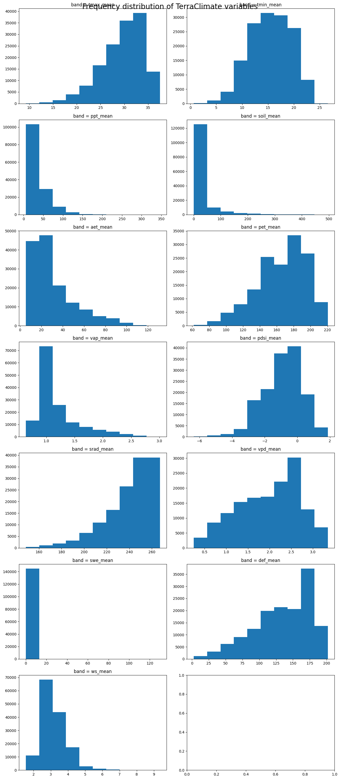
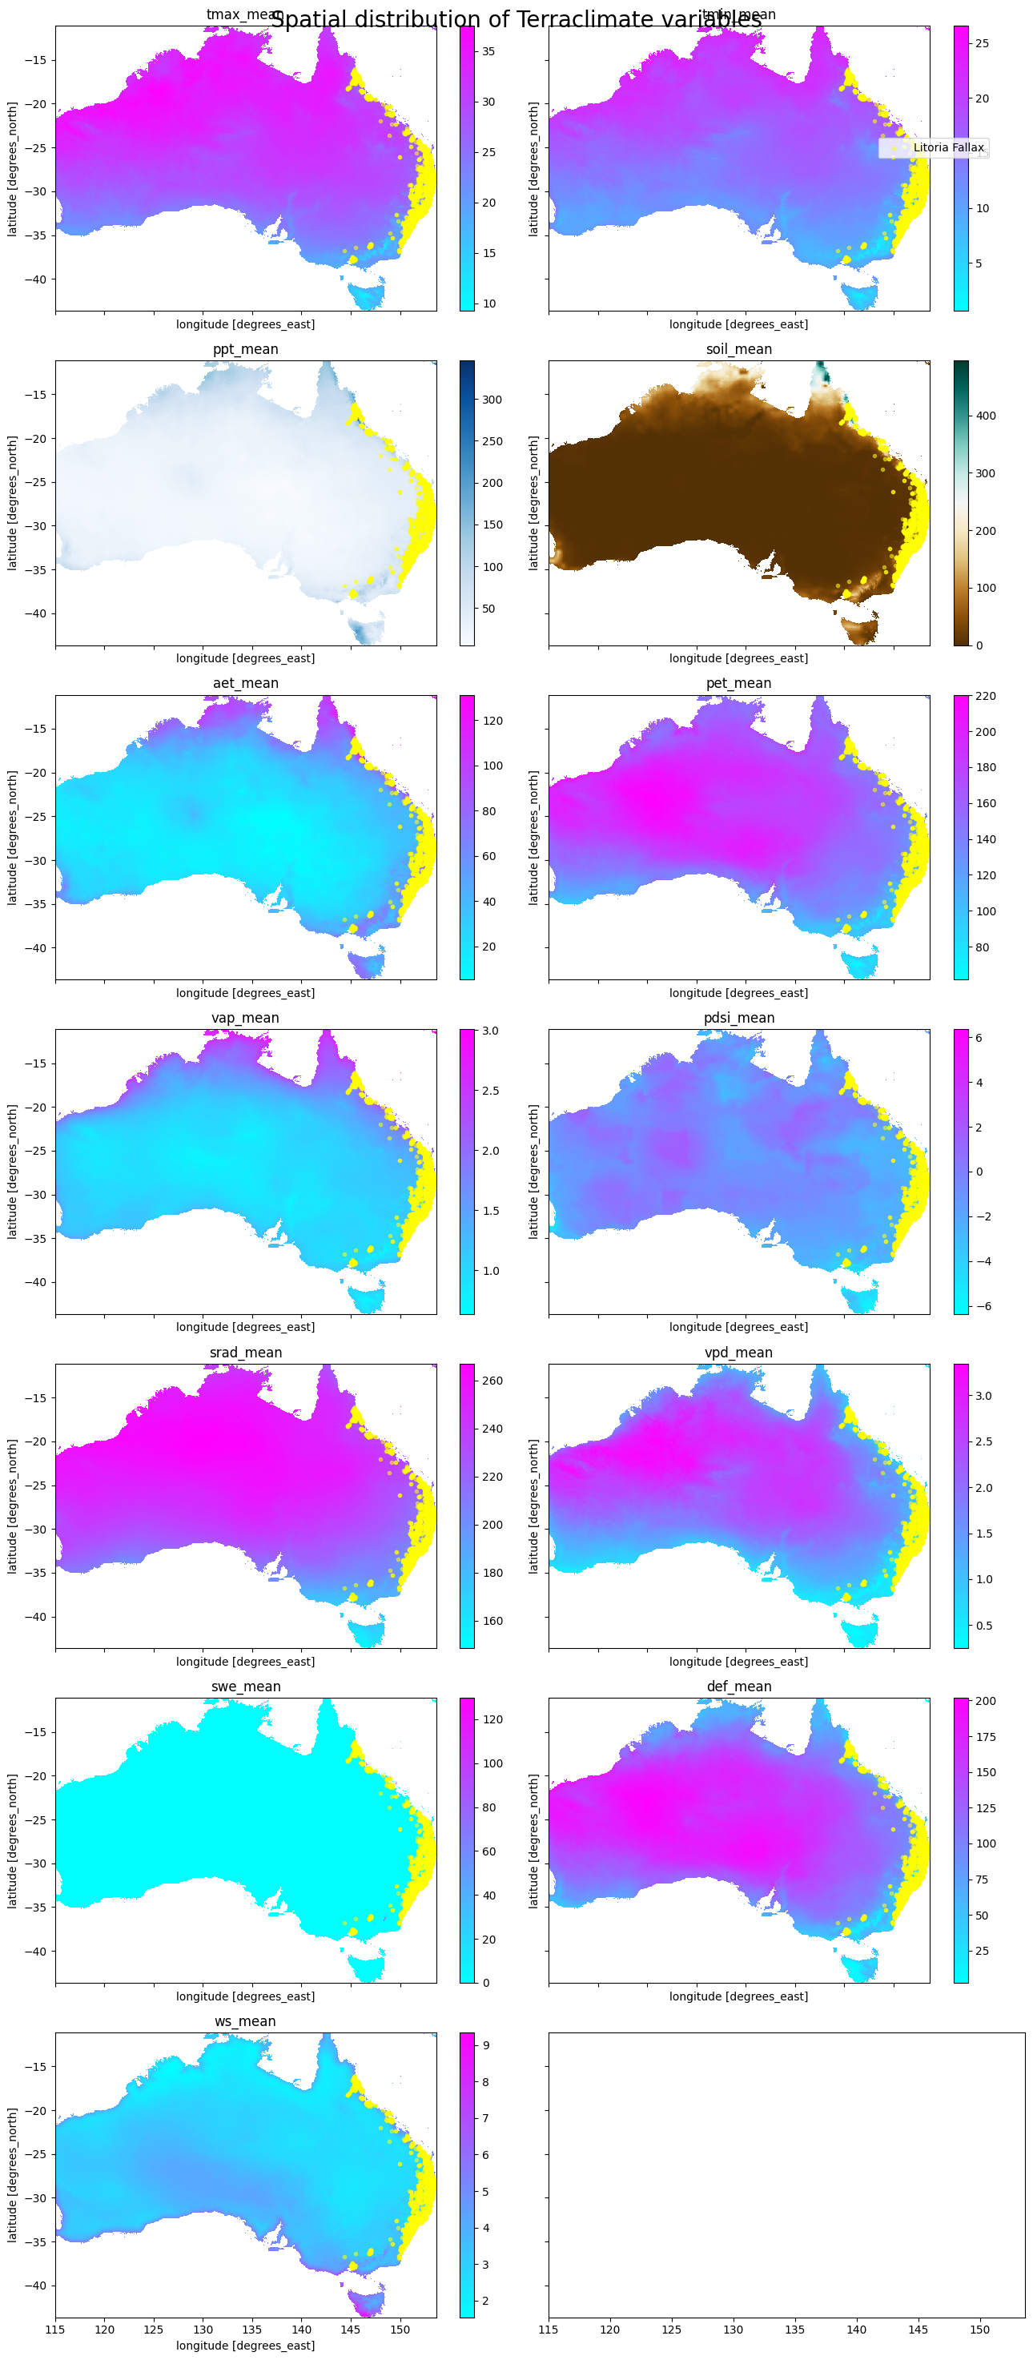
Spatial and Frequency Distribution
Used the same reference notebook
Took all features except Runoff

Slide 6
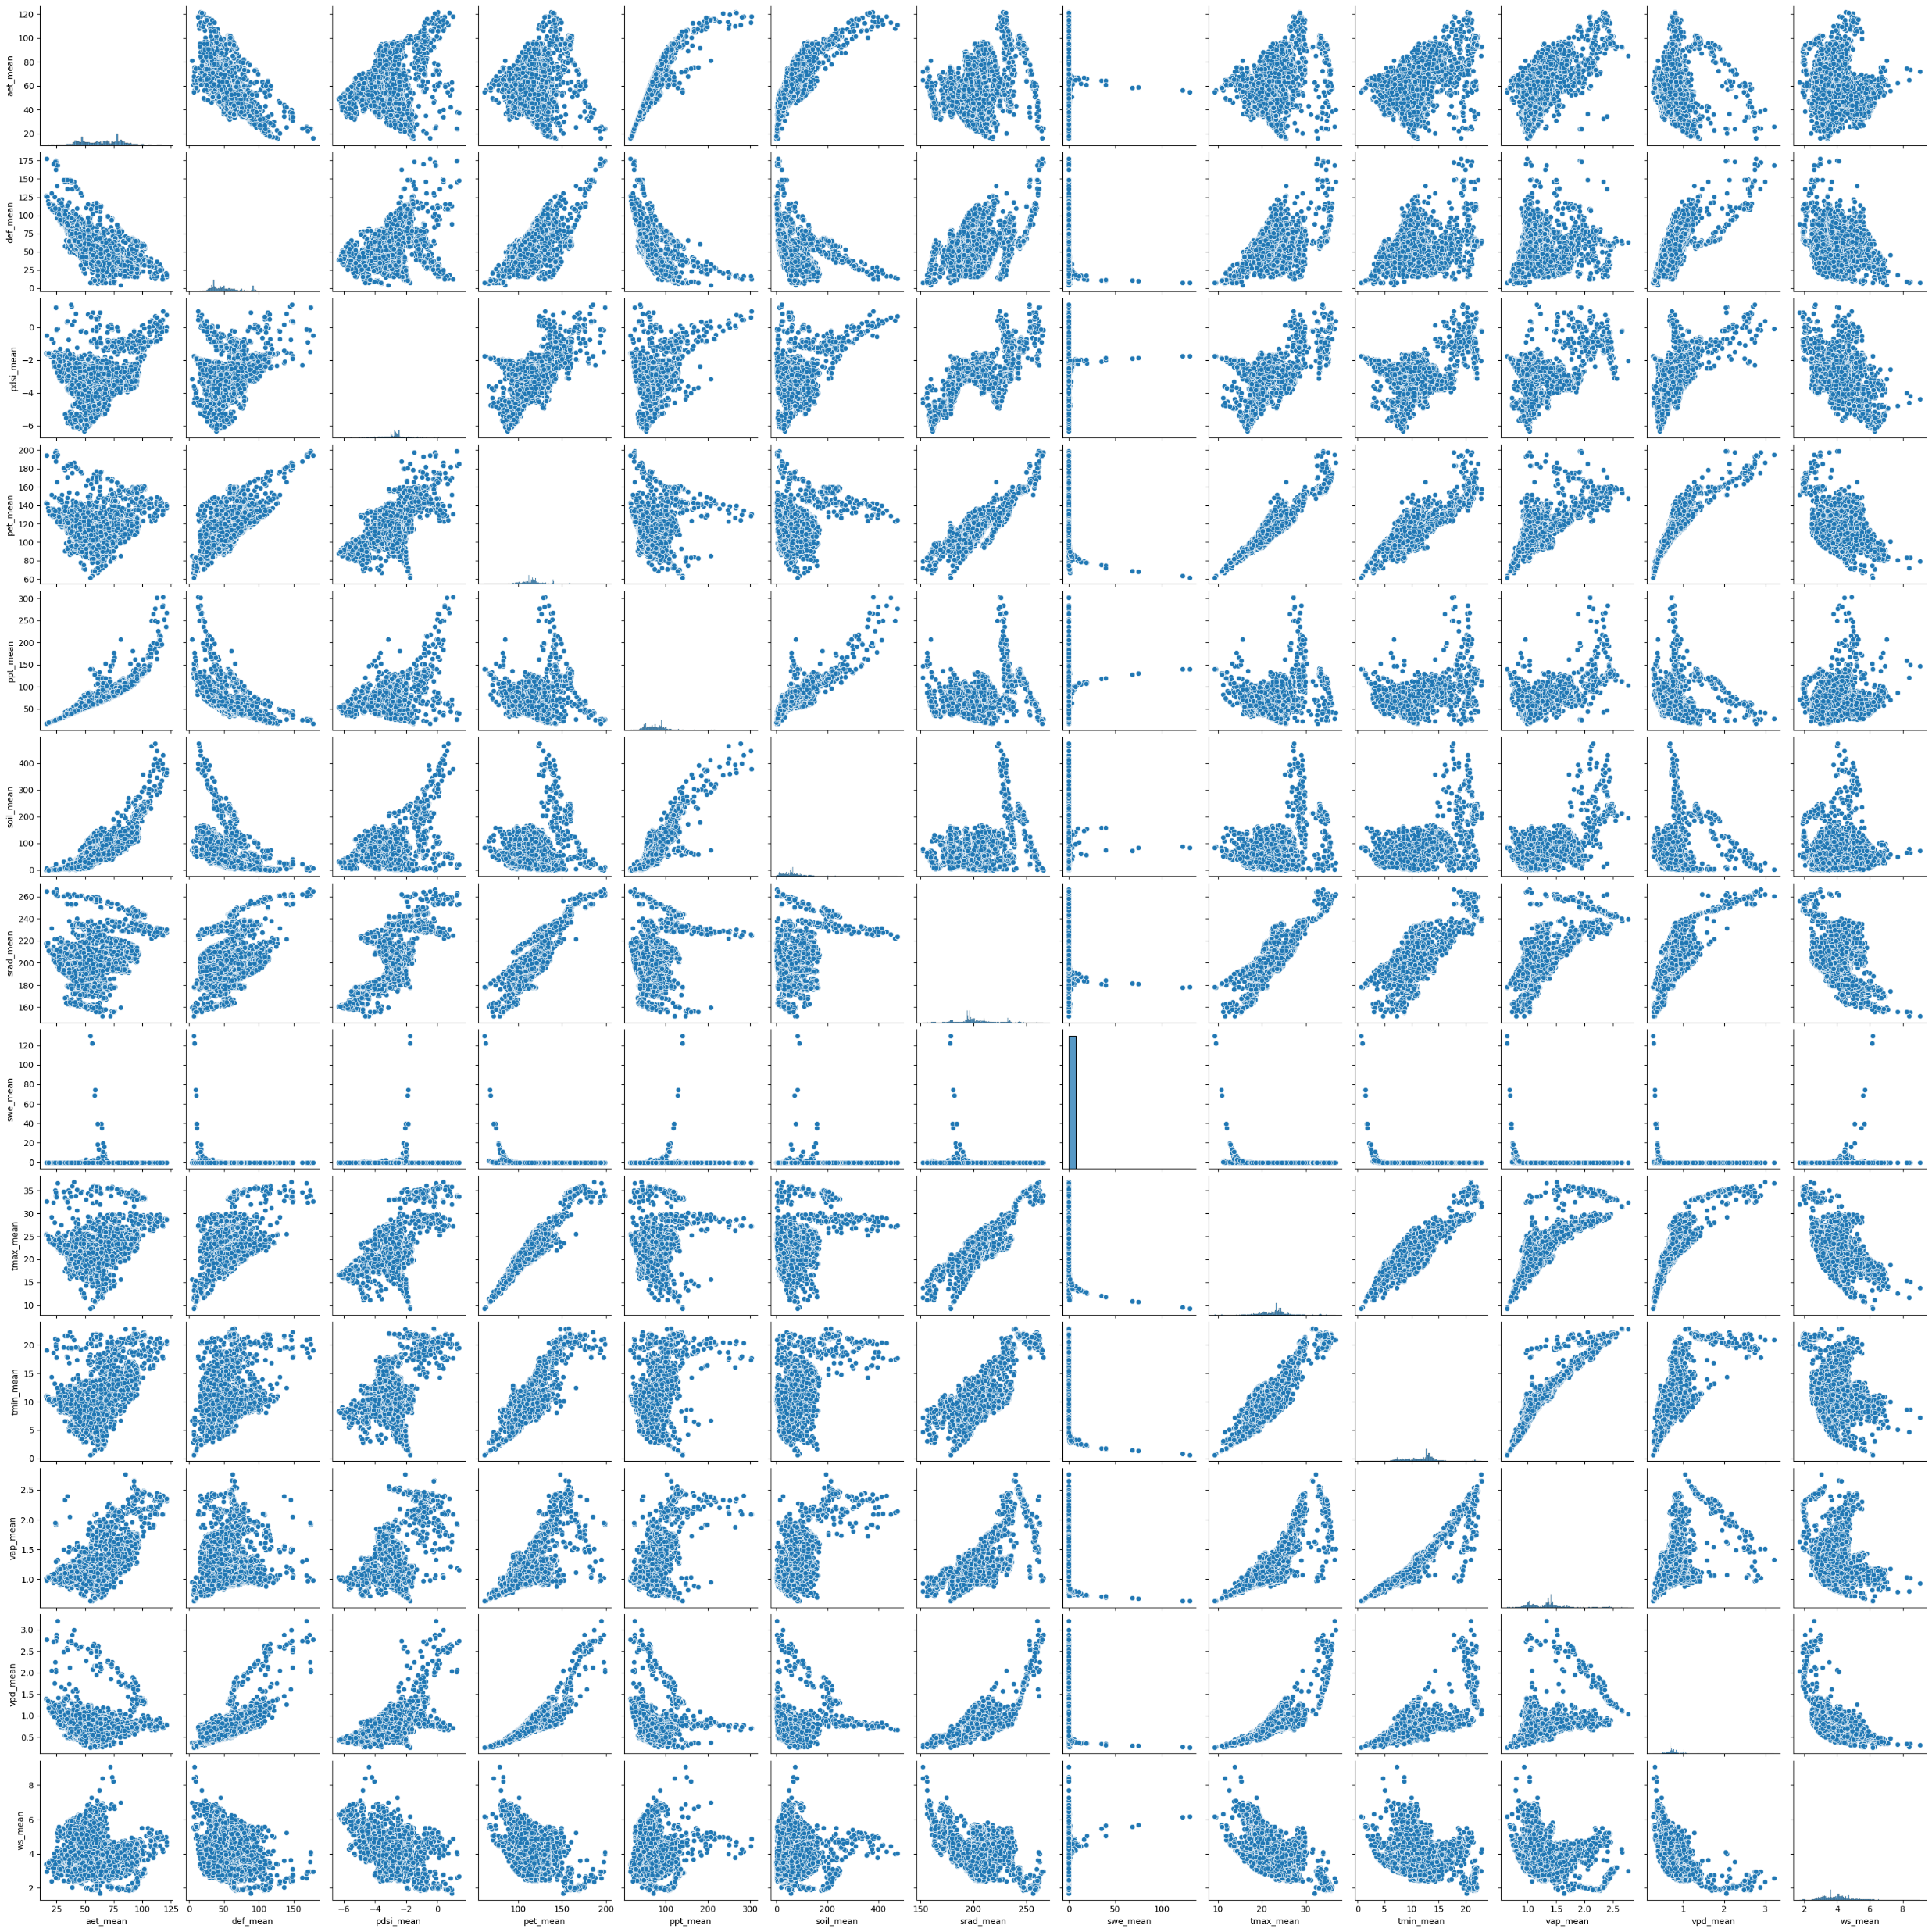
Feature Dependency

Slide 7
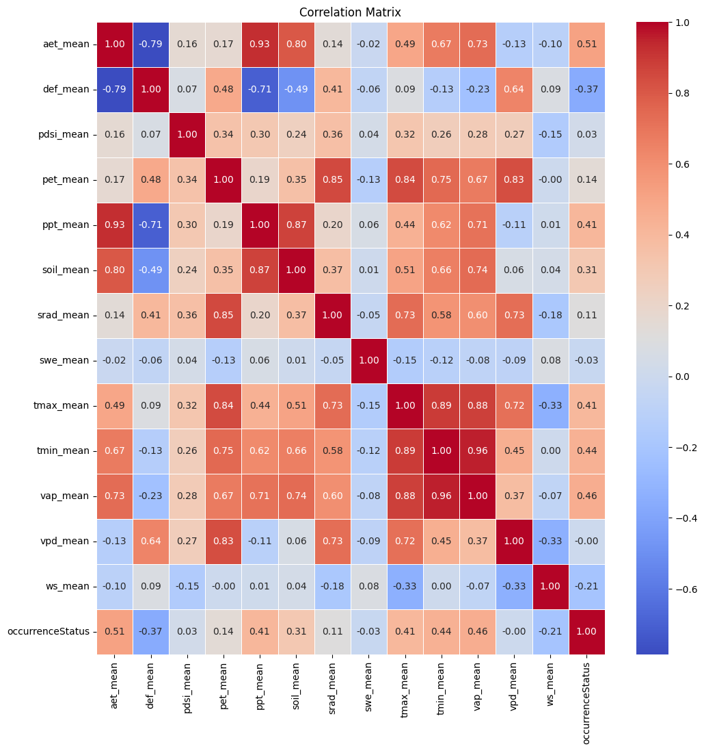
Correlation matrix

Slide 8
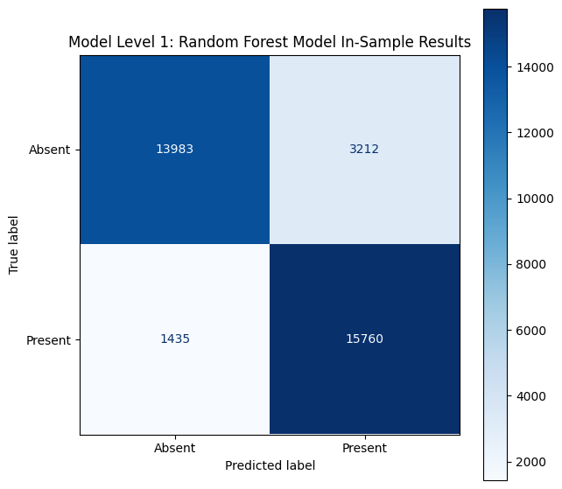
Models and validation predictions
Model | Cross Validation Accuracy | Cross Validation F1
Random Forest | 0.86 | 0.86
LightGBM | 0.86 | 0.86
Decision Tree | 0.85 | 0.86
SVM | 0.79 | 0.82

Slide 9
Why F1 score in the test is not as high as expected?
We got 0.74 using Random Forest and Decision Tree

Slide 10
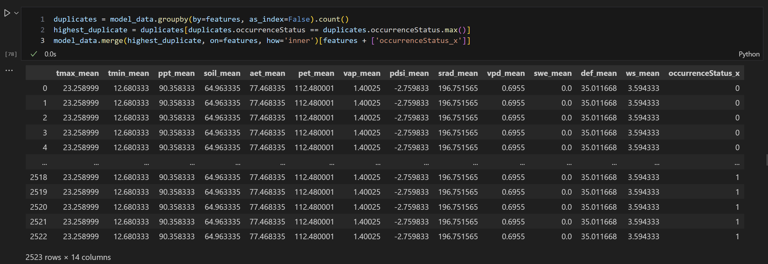
Observation 1 – Is data really big?
Overlapping data
Actual data is 95% smaller
59216 rows originally but 2984 rows are unique

Slide 11
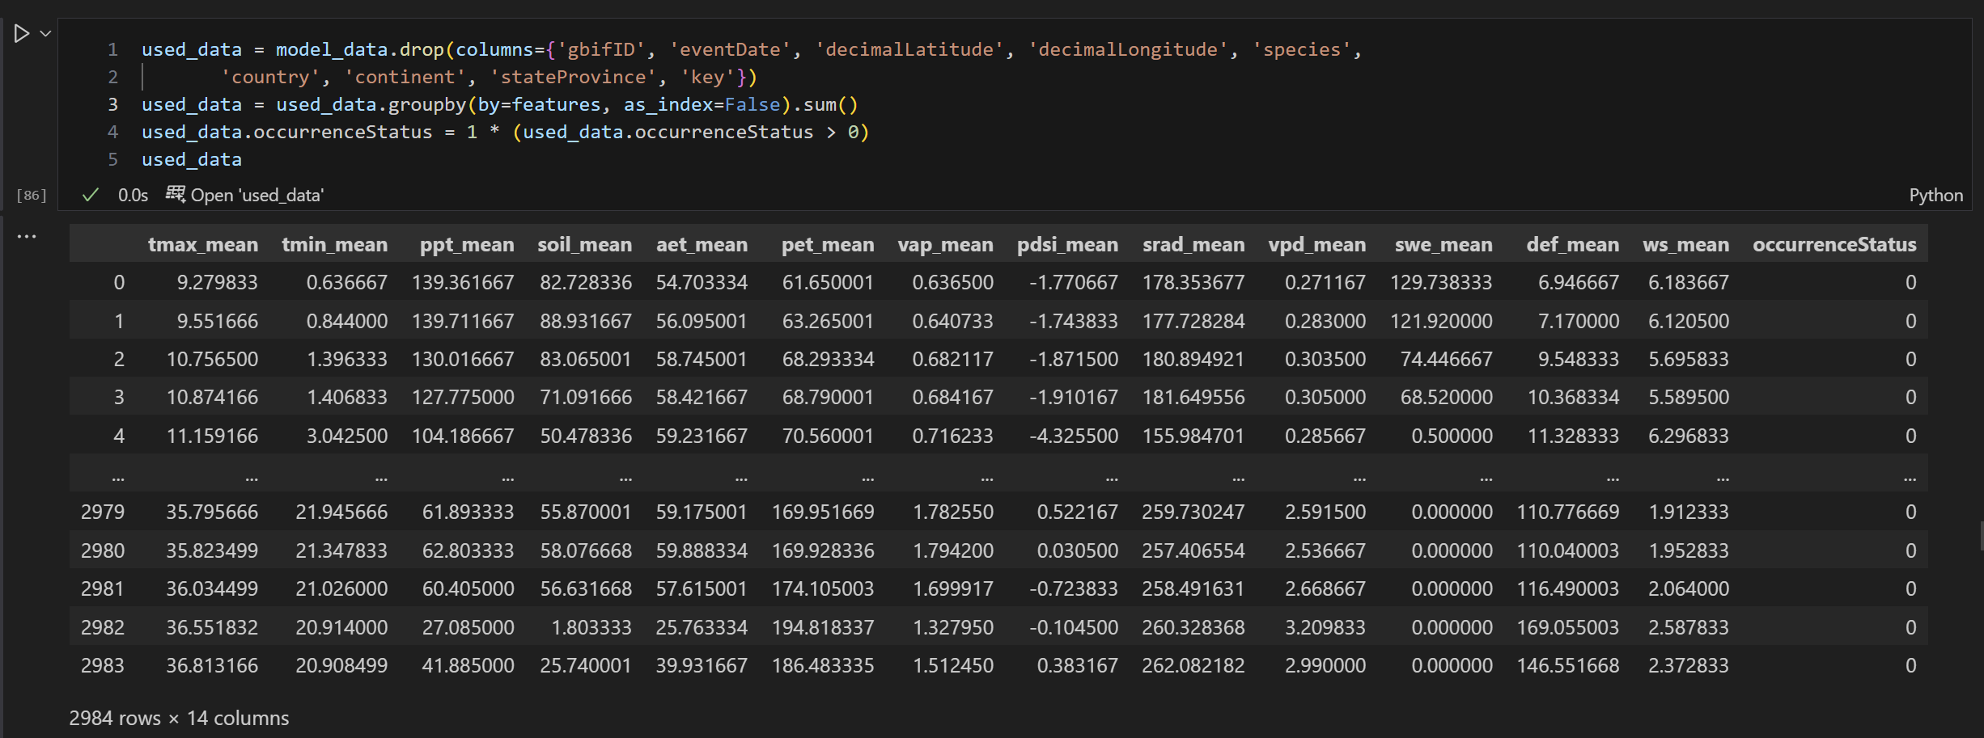
What did we do?
Reduced data to such a small size
OccurrenceStatus set to one even if one entry of Litoria Fallax is present in that feature set.

Slide 12
Models and validation predictions
Model | Cross Validation Accuracy | Cross Validation F1
Random Forest | 0.85 | 0.86
LightGBM | 0.86 | 0.86
Decision Tree | 0.85 | 0.86
SVM | 0.79 | 0.82

Slide 13
We still didn’t get good F1 score
0.68 for LighGBM

Slide 14
Observation 2 – Reason for little Information
Data collected is the average climate data for the year 2017-2019 irrespective of time
Does not reflect current weather conditions for the frog presence

Slide 15
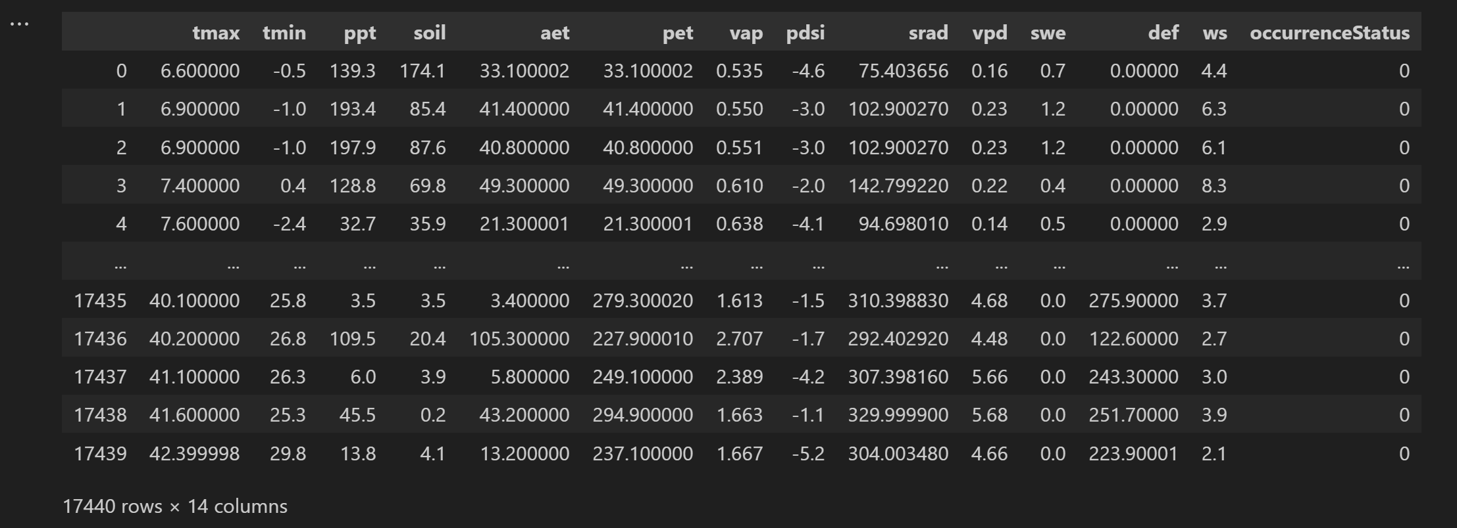
What we did?
Taken data to the nearest time, latitude, and longitude
Learnt to collect data from xarray faster
Increment in rows from 2984 to 17440

Slide 16
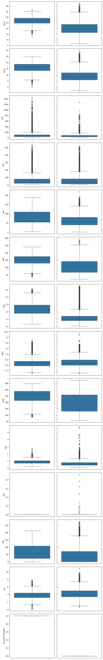
Feature reading
Litoria Fallax, on average, is present in areas having
High-temperature
High Actual Evapotranspiration

Slide 17
Feature reading - Continued
Litoria Fallax, on average, is present in areas having
More Vapor Pressure
More Downward Short wave radiation flux
More Climate Water deficit
Less windy area

Slide 18
Models and Validation Predictions
Model | Cross Validation Accuracy | Cross Validation F1
Logistic Reg | 0.82 | 0.66
GaussianNB | 0.73 | 0.67
Random Forest | 0.59 | 0.27
Decision Tree | 0.79 | 0.56
LightGBM | 0.81 | 0.88
Uploaded the results using lightGBM model
Unable to get a good F1 score
Implies our data is yet to be refined.

Slide 19
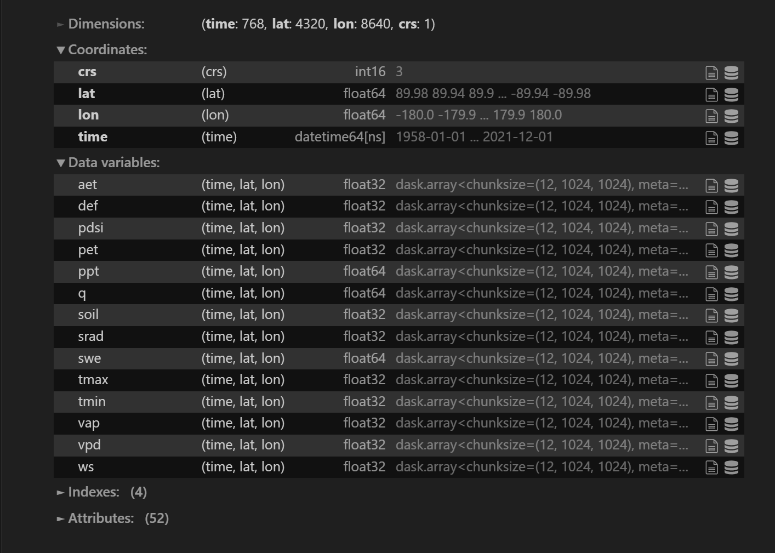
Observation 3 – Satellite data
Occurrence dataset:
Latitude and longitude data: 6 decimal points
Time data: Accurate to minutes
Satellite dataset:
Latitude and Longitude data: 2 decimal points
Time data: Some dates are missing
Disparity is 51 kilometers

Slide 20
Issues and after thoughts
Need to consider frog presence radius.
Need to calculate the time difference.
Consider different approaches - If the surrounding data of the test data contains our frog species, can we predict the presence of our frog in the test data

